Slide 1
HEDERA DATA API

Slide 2
Content
Api Usage
Data collection
Data structure comparison
Result overview

Slide 3
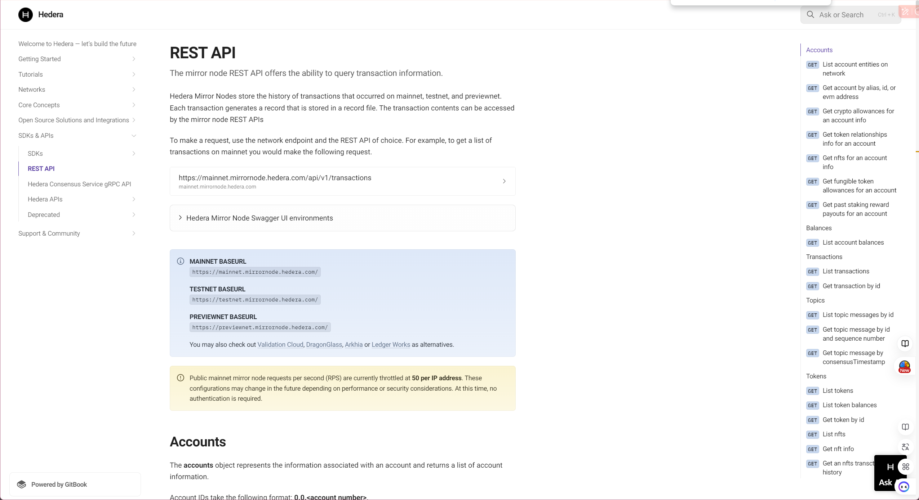
Hedera official document
Notes:
Hedera Mirror Nodes store the history of transactions that occurred on mainnet, testnet, and previewnet. Each transaction generates a record that is stored in a record file. The transaction contents can be accessed by the mirror node REST APIs. (https://docs.hedera.com/hedera/sdks-and-apis/rest-api)

Slide 4
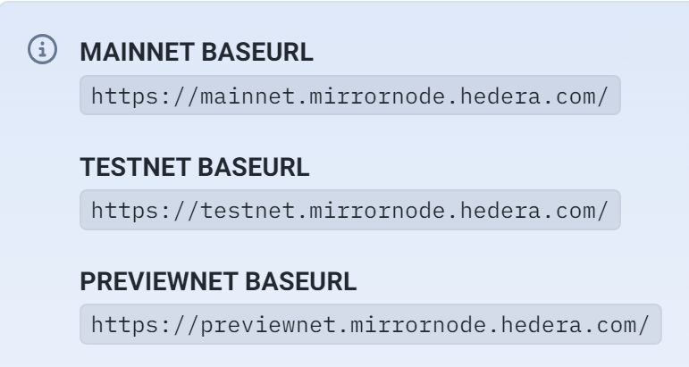
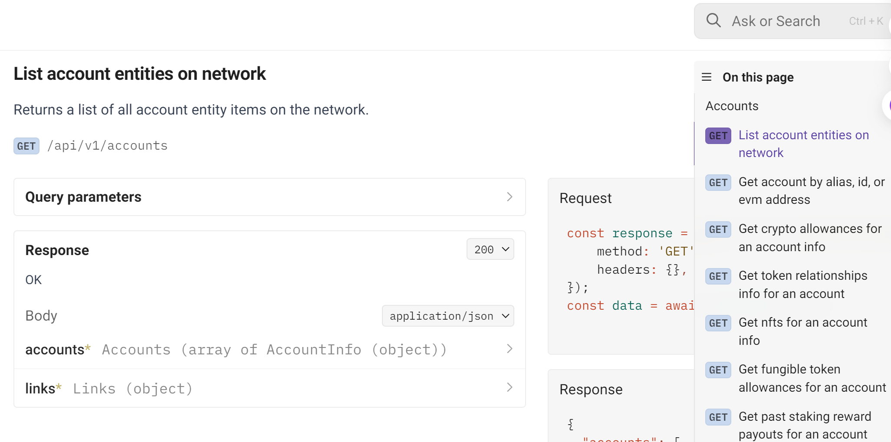
REST API USAGE
To make a request, use the network endpoint and the REST API of choice. For example, to get a list of account entity on mainnet you would make the following request
1. base url
2. Sub url
Notes:
Base_url + suburl = what you want

Slide 5
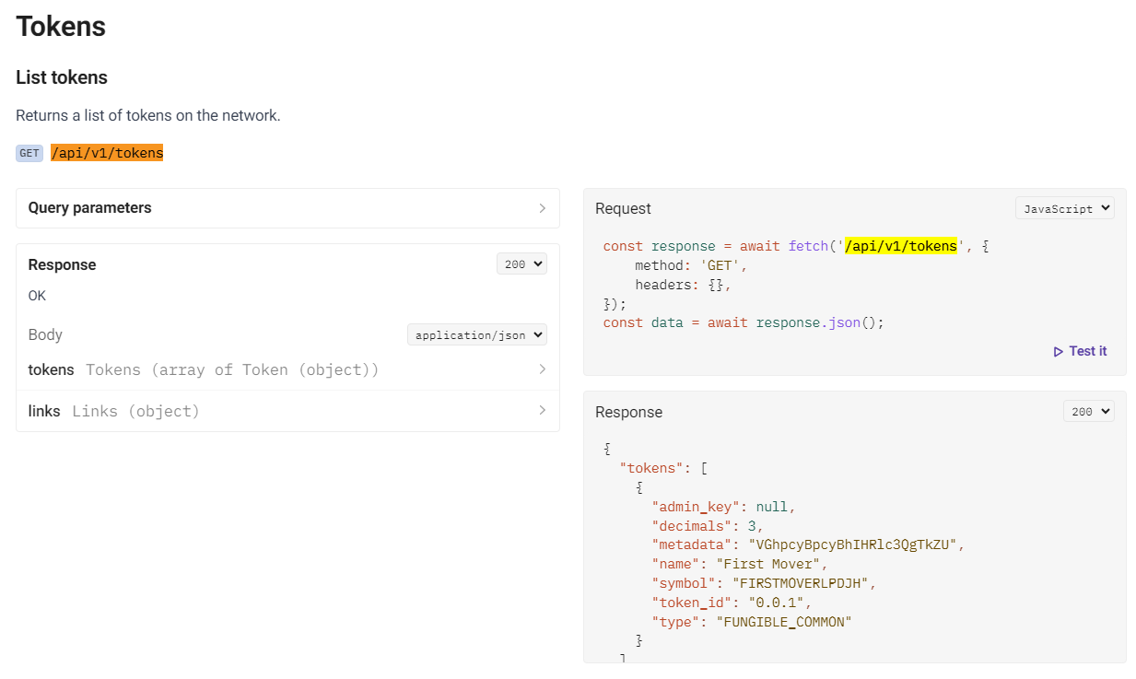
Data Acquisition Solution
/api/v1/tokens
Notes:
Get 29,011 contracts in hedera block chain, 25,811 traded

Slide 6
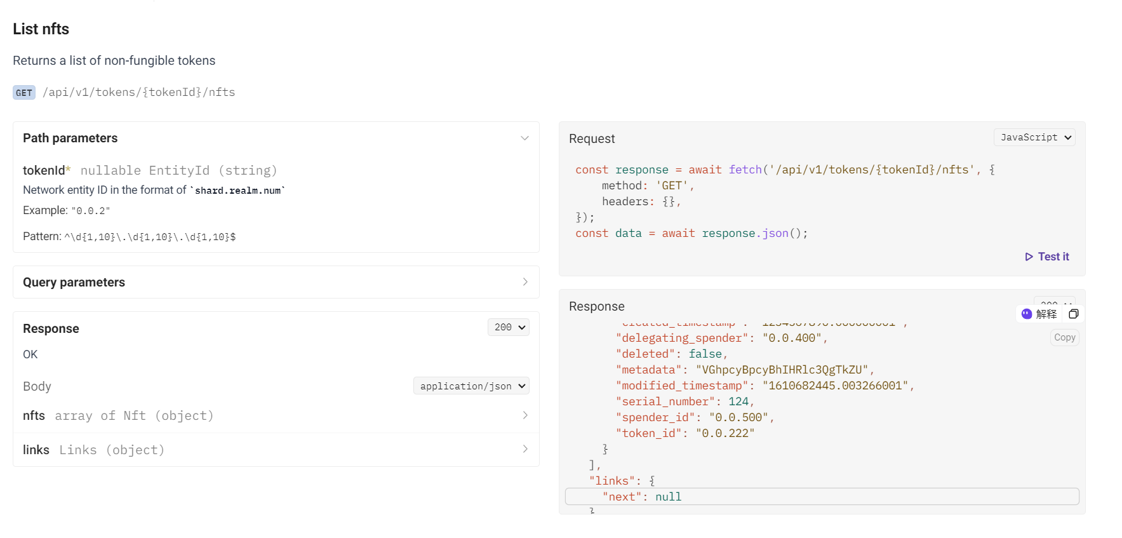
Data Acquisition Solution
/api/v1/tokens/{tokenId}/nfts
Notes:
Use token id of each contracts to get each series number of each token id

Slide 7
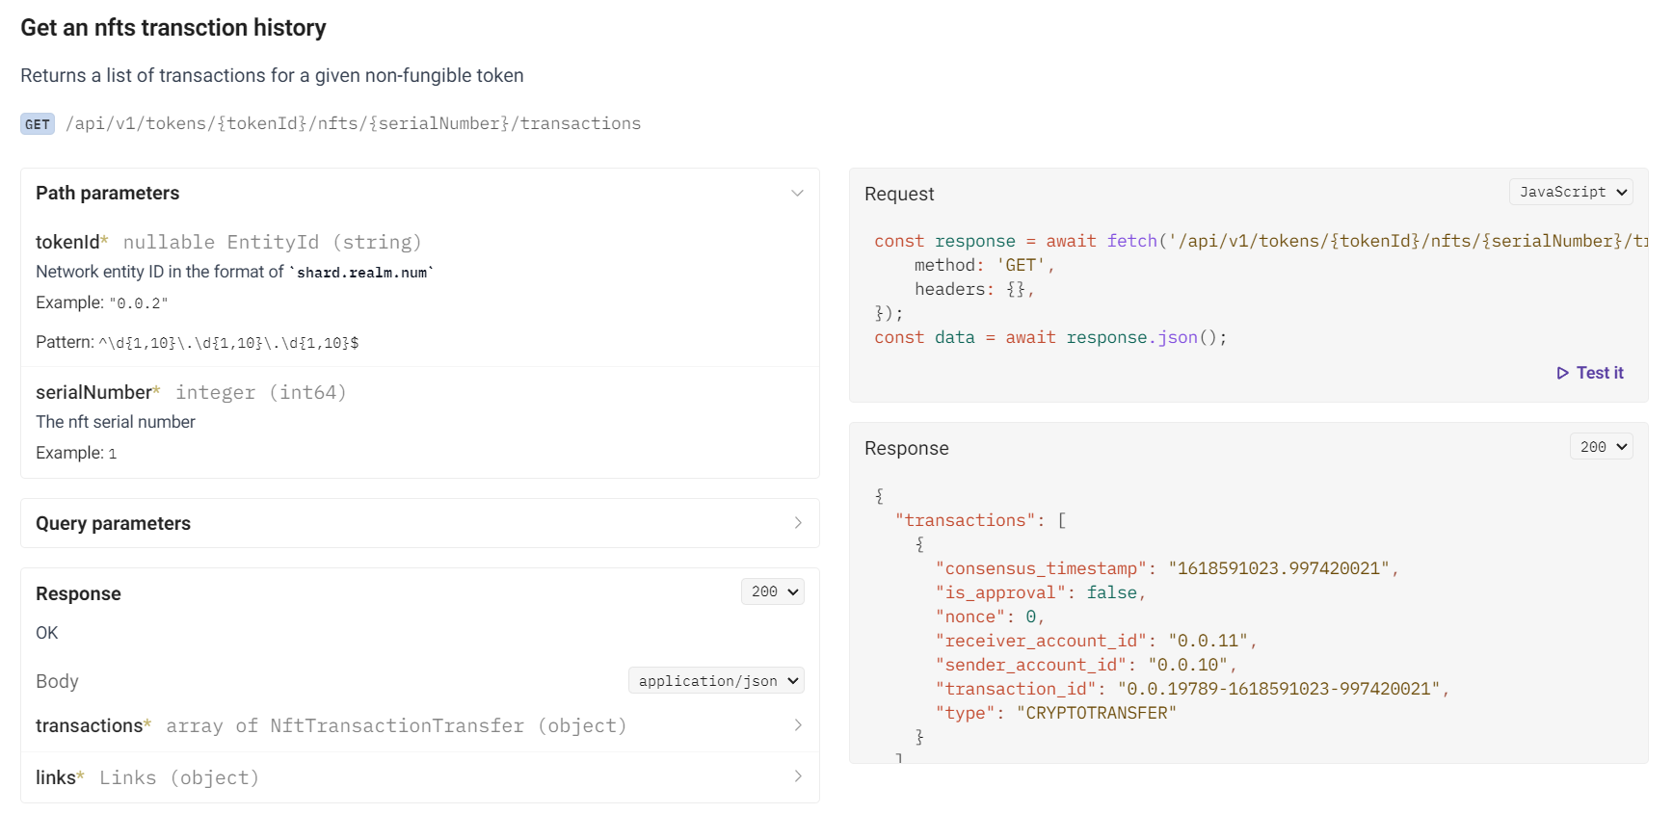
Data Acquisition Solution
/api/v1/tokens/{tokenId}/nfts/{serialNumber}/transactions
Notes:
Iterate over all the token and series number of each contract above to get the transactions (mint ,deleted , cryptos transfer,cryptos trades ) for each contract
Total 9 M + transactions records in hedera up to 2024/ 8/26

Slide 8
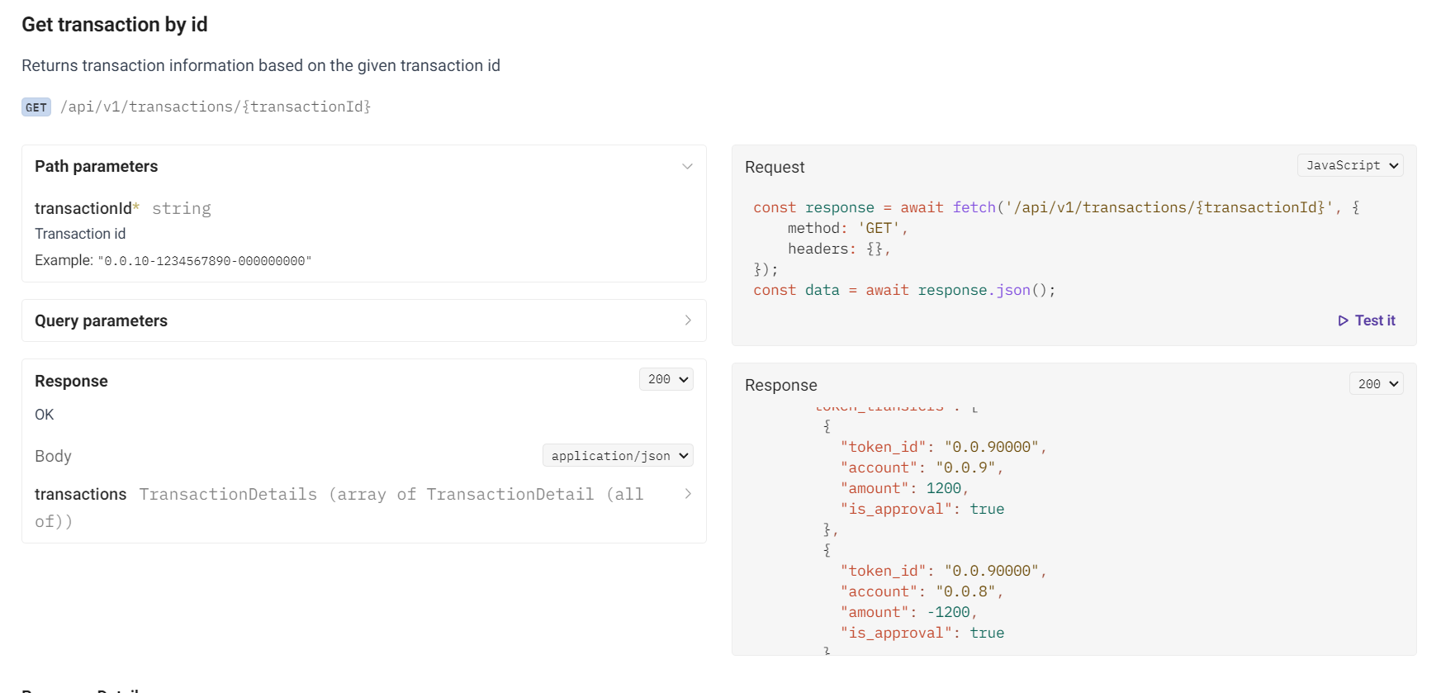
Data Acquisition Solution
/api/v1/transactions/{transactionId}
Notes:
Use the transaction hash to get sender and receiver details accounts detail in the transaction ，Get the Top 10 volumes contracts detail and to calculate the concentration index ,comparison data and so on

Slide 9

The whole Data solation Flow chart
caculation
index
business
Ethereum
compason
All contract tokens
All the series numbers of each contract
Transaction details, Transaction account detail
hedera
node
api1
api2
api3
daily maintaince
Traders
Hedera
report
Newbies
Notes:
flow diagram

Slide 10
Field different
Filed name | Description
consensus timestamp | The consensus timestamp in seconds.nanoseconds
transaction hash | The hash value of the transaction processed on the Hedera network
valid start timestamp | The time the transaction is valid
charged tx fee | The transaction fee that was charged for that transaction
transaction id | The ID of the transaction
memo base64 | The memo attached to the transaction encoded in Base64 format
result | Whether the cryptocurrency transaction was successful or not
entity ID | The entity ID that is created from create transactions (AccountCreateTransaction, TopicCreateTransaction, TokenCreateTransaction, ScheduleCreateTransaction, ContractCreateTransaction, FileCreateTransaction).
name | The type of transaction
max fee | The maximum transaction fee the client is willing to pay
valid duration seconds | The seconds for which a submitted transaction is to be deemed valid beyond the start time. The transaction is invalid if consensusTimestamp is greater than transactionValidStart + valid_duration_seconds.
node | The ID of the node that submitted the transaction to the network
transfers | A list of the account IDs the crypto transfer occurred between and the amount that was transferred. A negative (-) sign indicates a debit to that account. The transfer list includes the transfers between the from account and to account, the transfer of the node fee, the transfer of the network fee, and the transfer of the service fee for that transaction. If the transaction was not processed, a network fee is still assessed.
token transfers | The token ID, account, and amount that was transferred to by this account in this transaction. This will not be listed if it did not occur in the transaction
assessed custom fees | The fees that were charged for a custom fee token transfer
links.next | A hyperlink to the next page of responses
Notes:
‘Link.next ’ next page

Slide 11
achievements
All-in-one NFT Data Analysis Platform
Get 29011 contract
Get 9M+ transaction records
Get top 10 NFT transaction detail
data comparison : Ethereum vs Hedera

Slide 12
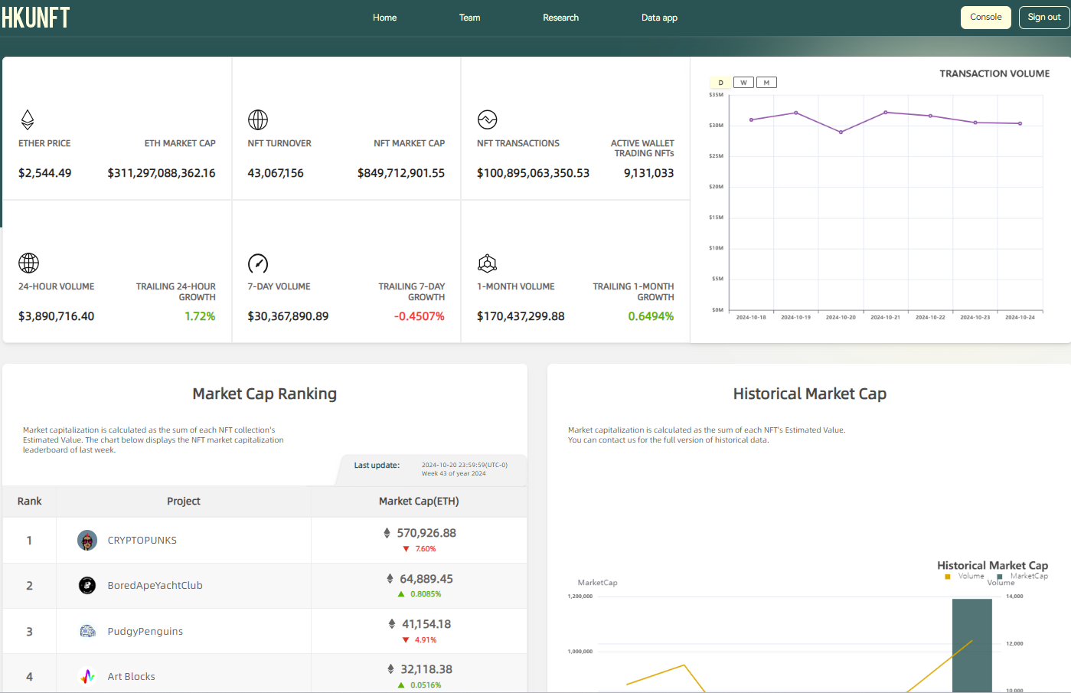
HKU NFT HOME PAGE
Notes:
Home page https://hku-nft.com/
Here are the features of the data analysis services provided by HKUNFT:
Real-Time Data Access: Users can seamlessly integrate real-time NFT data through a robust API service, facilitating application development.
No-Code Analytics Dashboard: Offers a no-code analytics tool that allows users to easily gain valuable insights into the NFT market.
Transaction Data Analysis: Analyzes sales volumes, prices, and buyer/seller behavior to help users identify market trends and dynamics.
Statistical Metrics Support: The API not only provides raw data but also supports statistical metrics, allowing users to retrieve needed information with simple code.
Research and Reports: Provides NFT-related research reports authored by researchers from top universities, helping users gain a deeper understanding of the market.
Extensive Data Coverage: Covers multiple markets with a vast number of NFT transfer records and collection data, ensuring comprehensiveness and accuracy.

Slide 13
Why HKU-NFT?
All-in-one NFT Data Analysis Platform
Comprehensive Data Insights
Customized Data Dashboard
Outstanding Academic Contributions
Top Academic & Development Team

Slide 14
All-in-one NFT Data Analysis Platform
On-Chain Data
HKU NFT Data Analysis Platform
Developers
HKU-NFT
API
OpenSea
Raw Data
Filtered Data
Key Metrics
Blur
HKU-NFT
Dashboard
Analysts
X2Y2
Web3
Node
Logs
Topic
Token_id
Transfer
Address
Volume
Market Cap
Strike Price
Transactions
Active Wallets
Minting
...
LooksRare
Cleaned
Augmented
HKU-NFT
Weekly Report
Traders
Zora
HKU-NFT
Lecture
Newbies

Slide 15
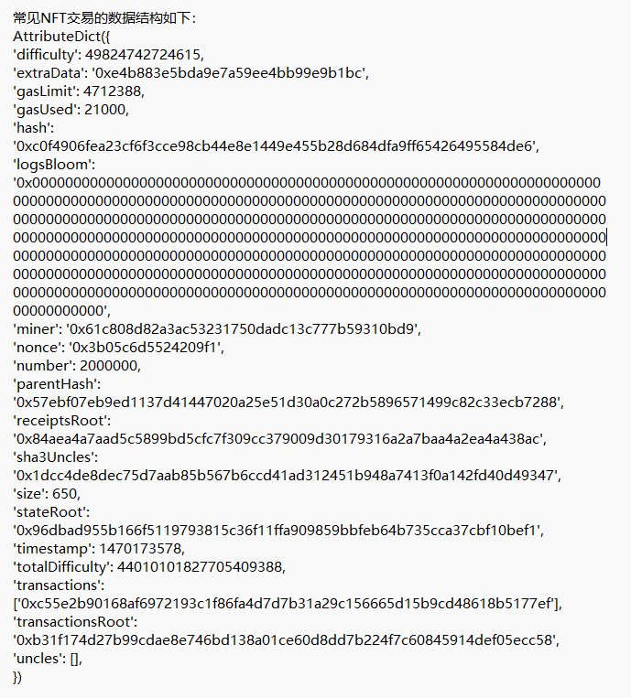
Comprehensive Data Insights
Key Metrics Extraction:
Analyzing critical data directly from the blockchain.
miner
parentHash
gasLimit
gasUsed
difficulty
extraData
hash
gasLimit
nonce
stateRoot
logsBloom
hash
extraData
sha3Uncles
timestamp

Slide 16
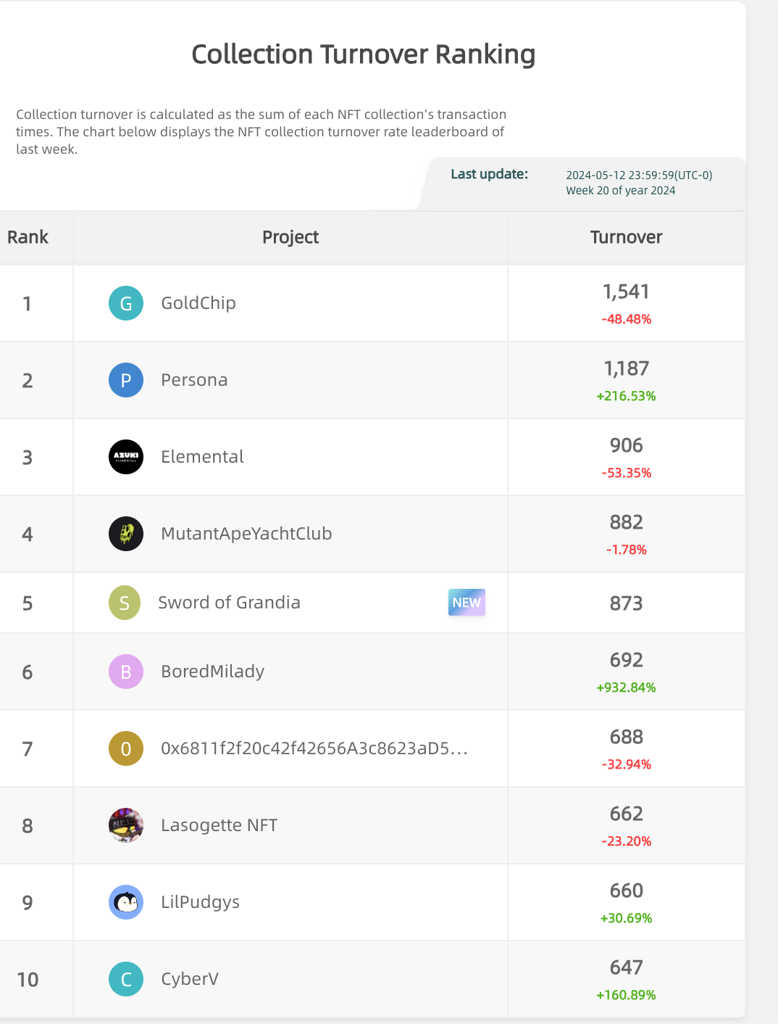
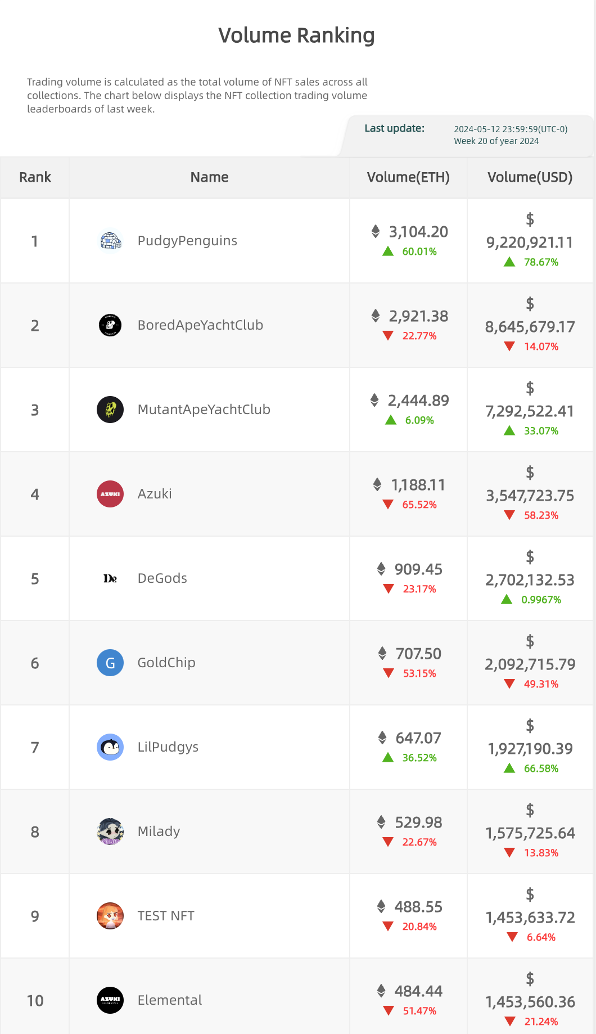
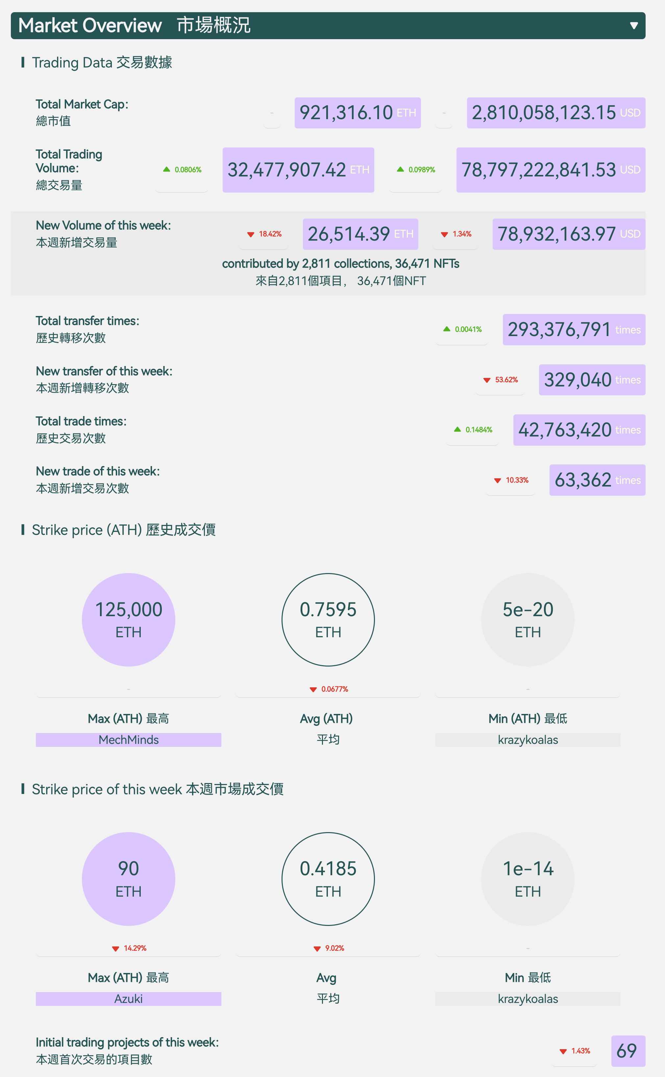
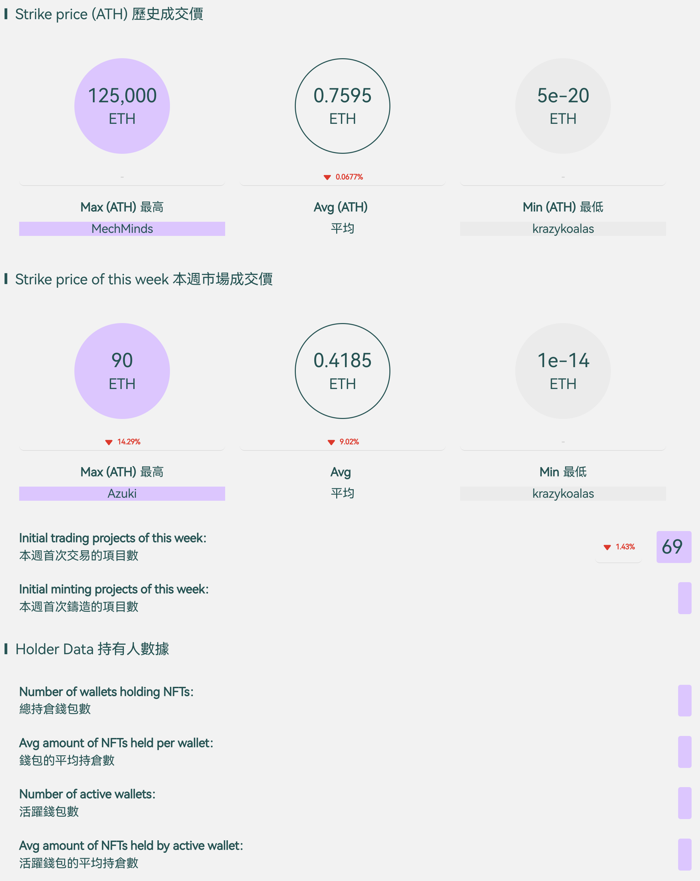
Comprehensive Data Insights
Financial Indicator Analysis:
Market Overview
Trading Volume
On-chain Transactions
Turnover

Slide 17
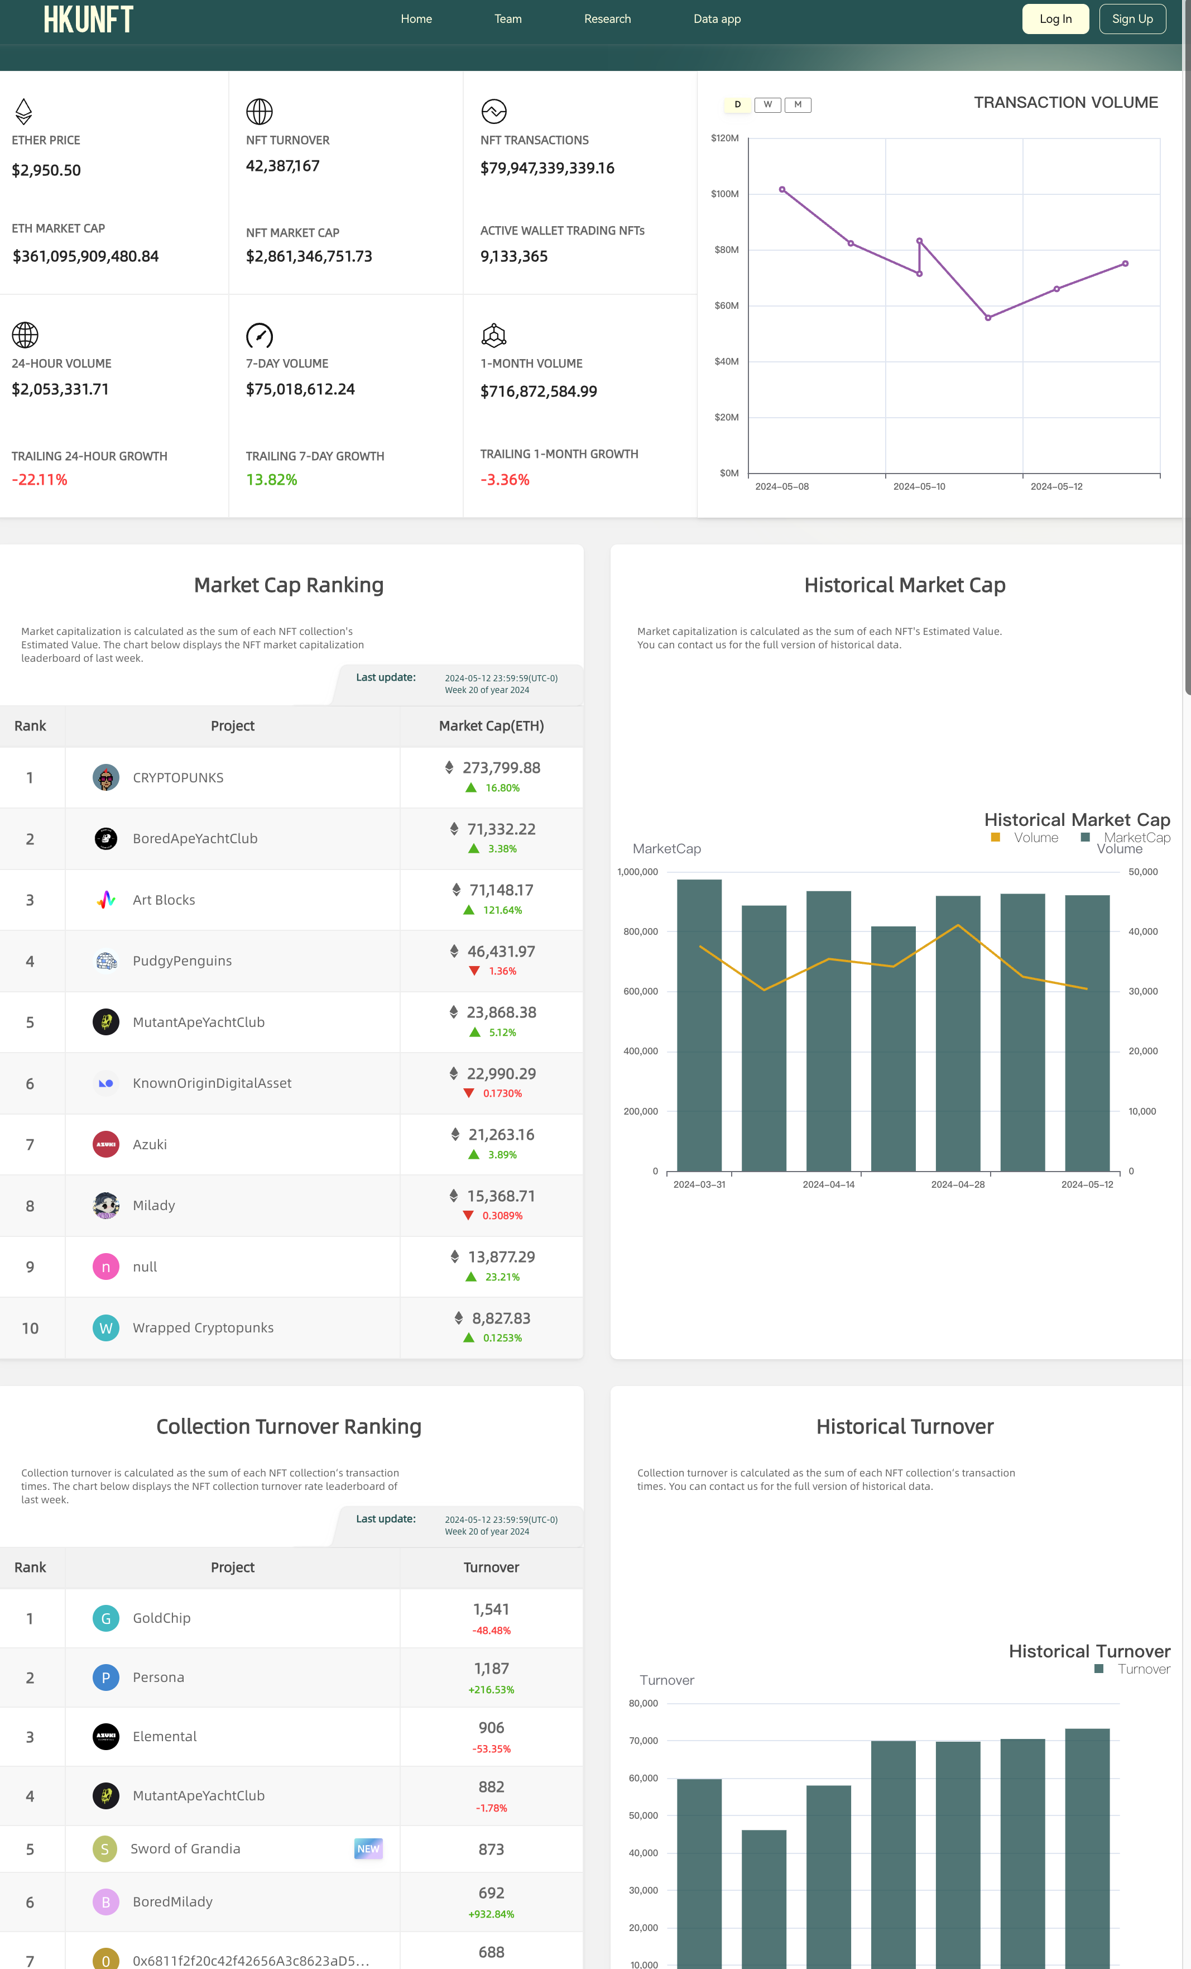
Customized Data Interface
NFT Data Dashboard
All-in-One View
Rankings & Trends
In-Depth Analytics

Slide 18
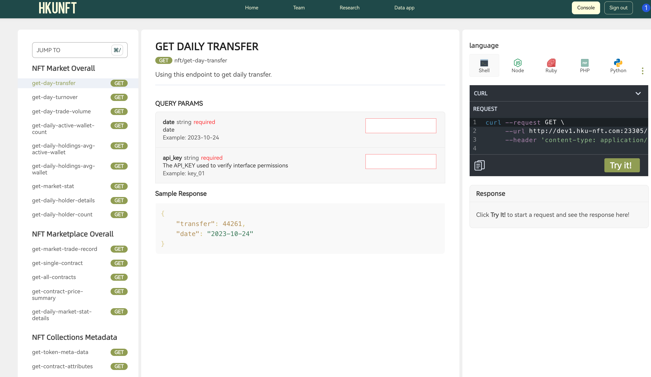
Customized Data Interface
APIs for Pro
Personalized API Keys
Seamless Integration

Slide 19
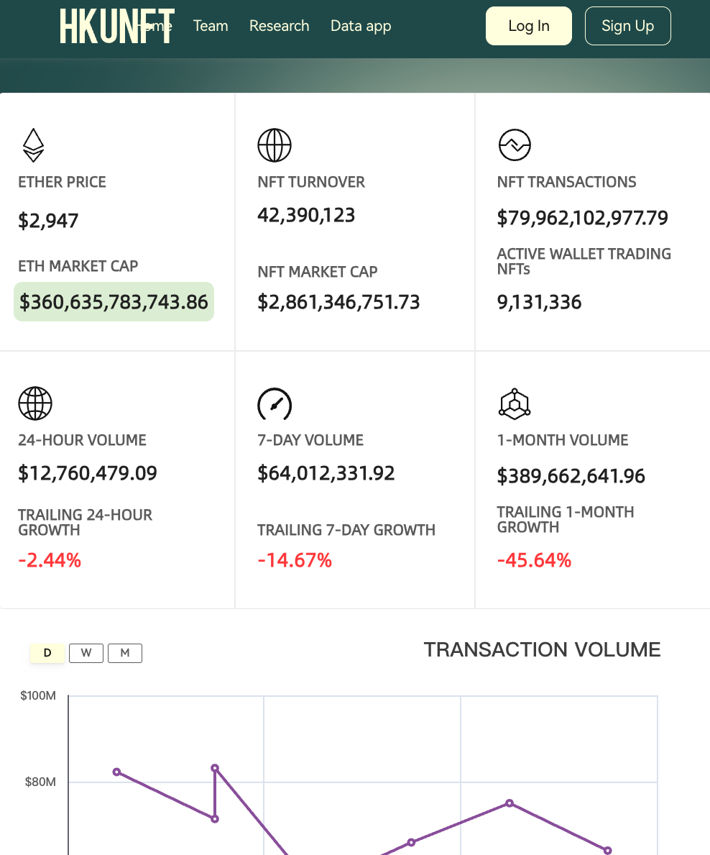
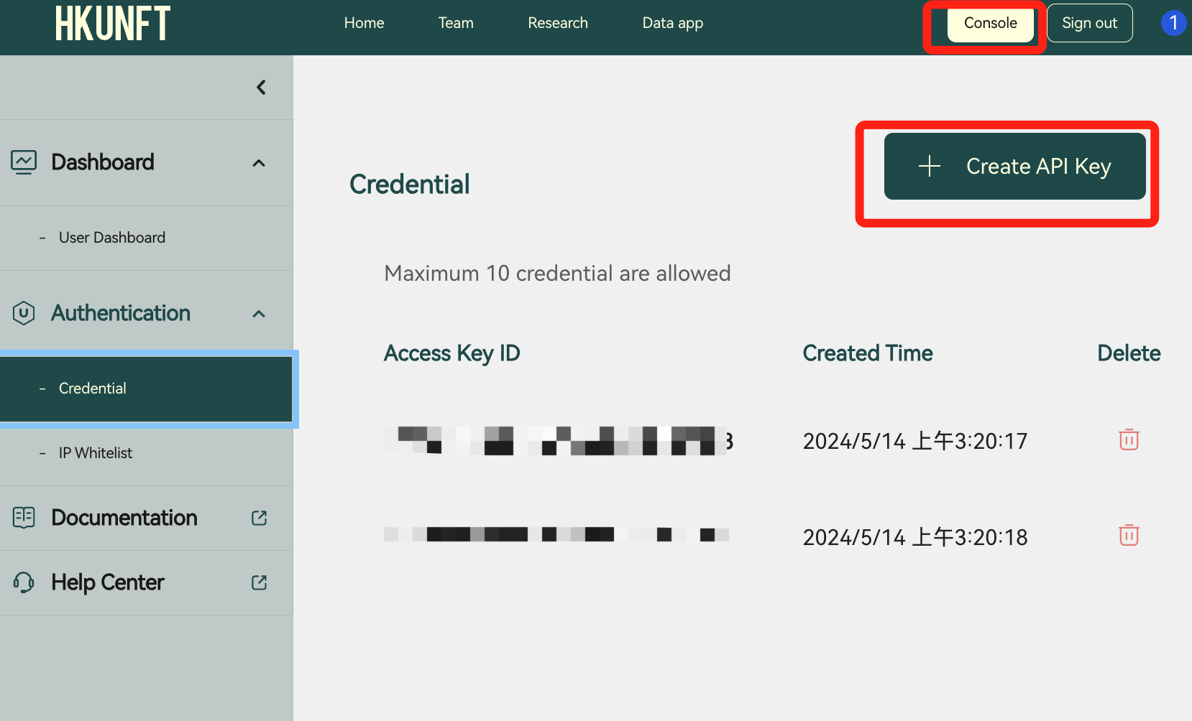
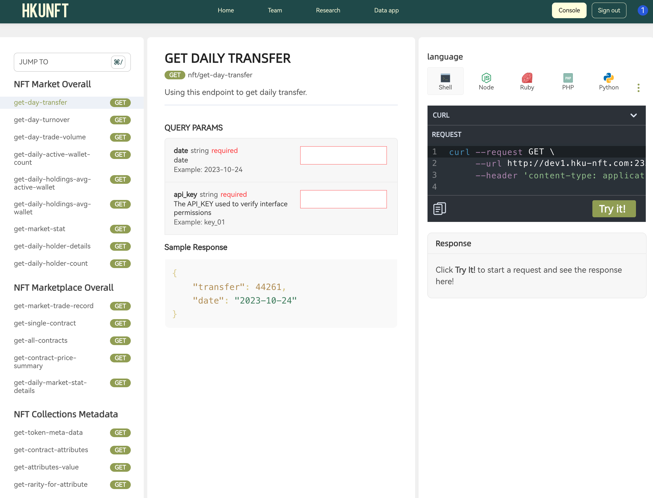
Customized Data Interface
APIs for Pro - A Step by Step Guide
1. Sign in
2. Enter the console and create your API key(keep it safe!)
3. Get cleaned NFT data

Slide 20
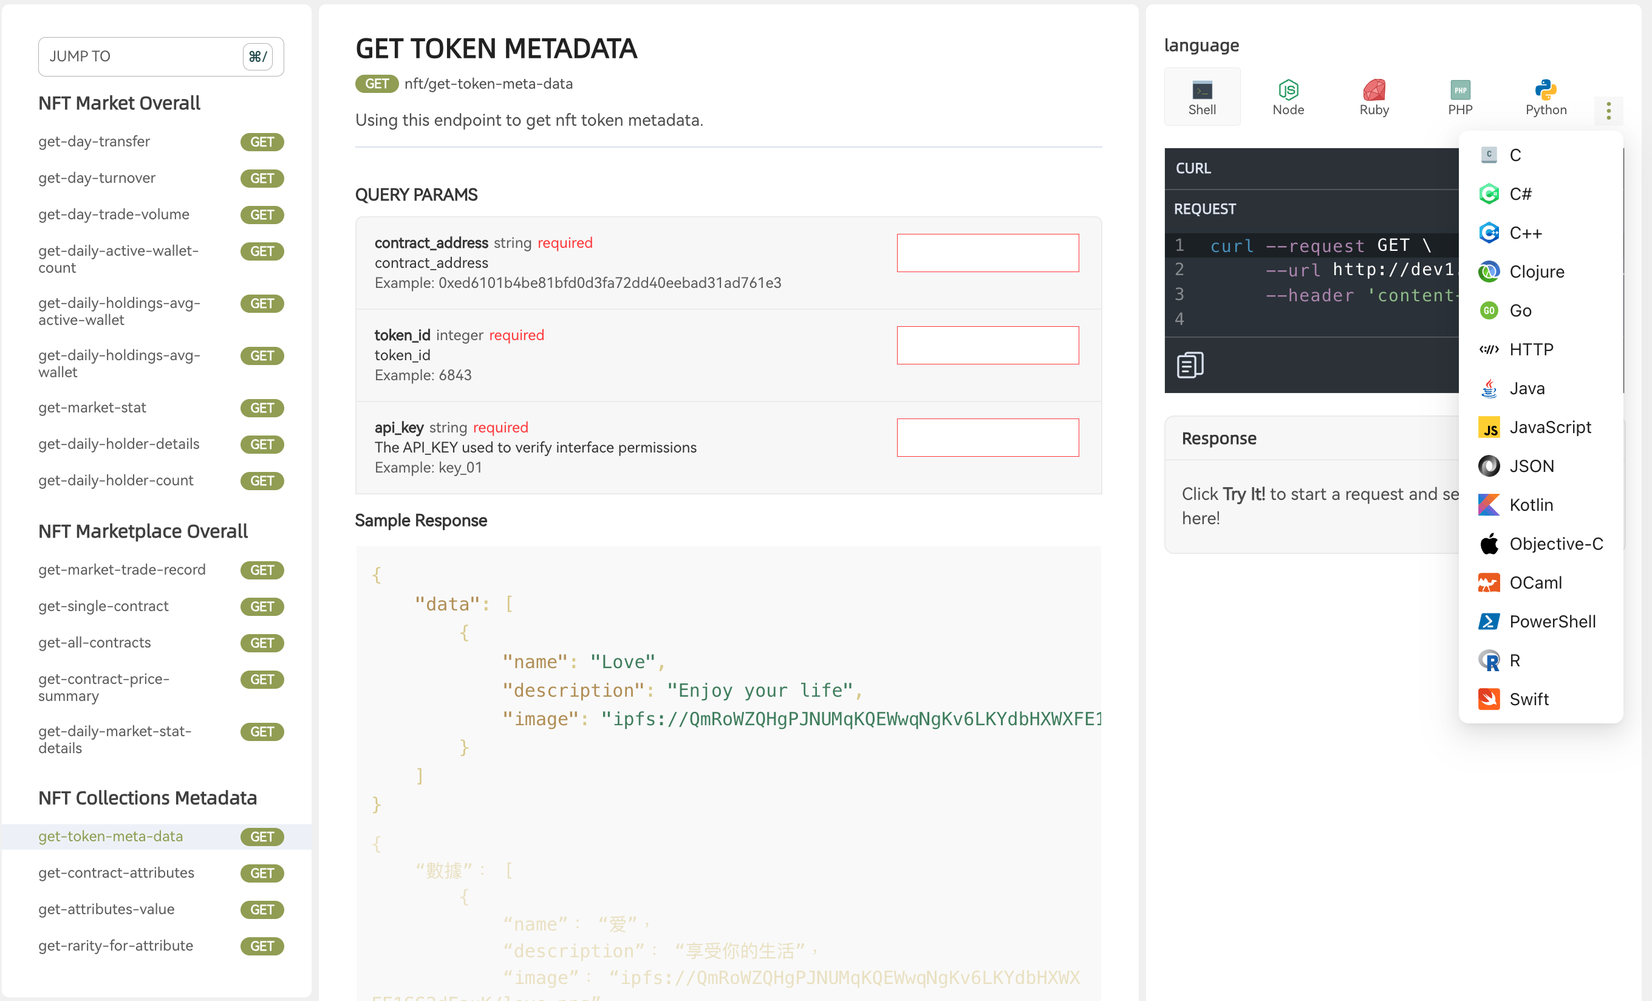
Customized Data Interface
APIs for Pro
20 Languages
18 Mtetrics
Filtered, Cleand, Augmented.

Slide 21
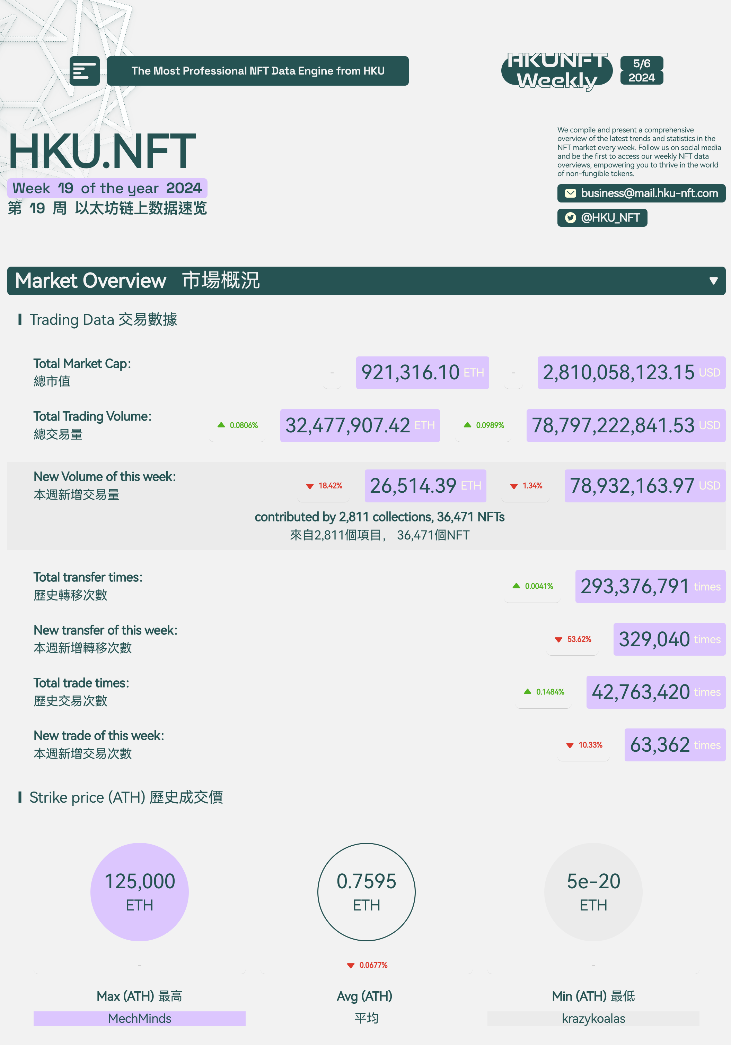
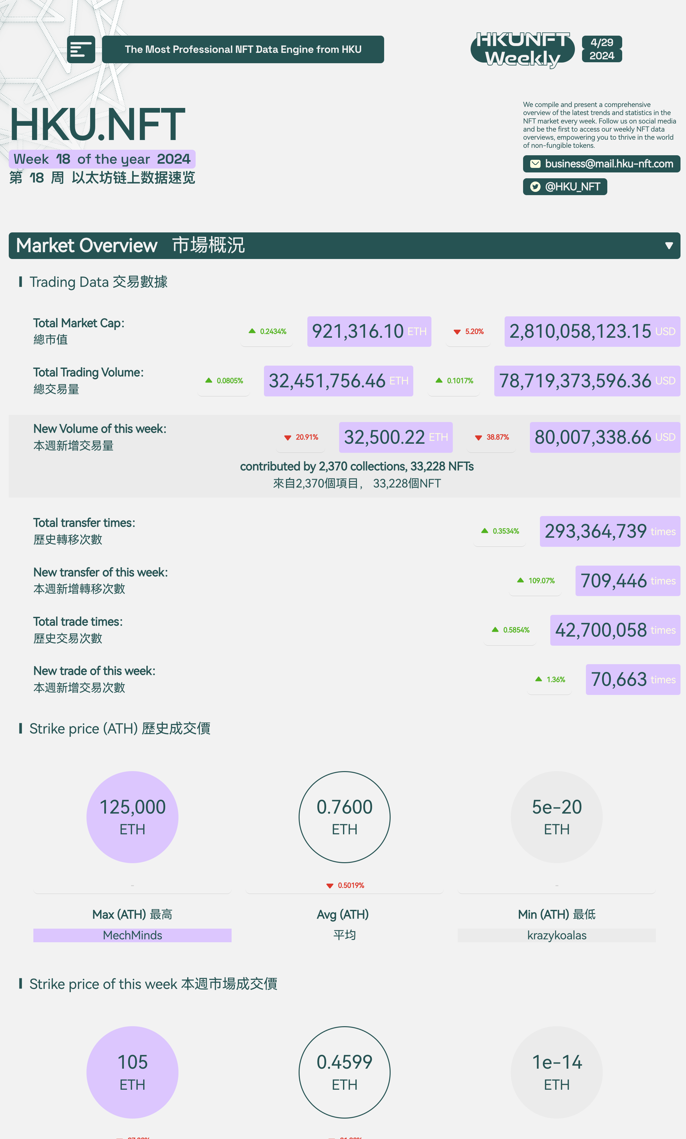
Customized Data Interface
In-depth Weekly NFT Report
Comprehensive Market Overview
Actionable Insights
Stay Ahead
Ideal for Decision-Makers

Slide 22
Outstanding Academic Contributions
Research Team & Publications
Our dataset, offering comprehensive and highly reliable NFT transaction data, is an invaluable resource for researchers. With clean and accurate data covering the majority of NFT transactions, it significantly streamlines academic research.

Slide 23
Outstanding Academic Contributions
Educational Curriculum Collaboration
For CS/Fintech:
Comprehensive blockchain technology theory
Smart contract development and DApp creation
Advanced blockchain/NFT data analysis
Computer vision for NFT image analysis and rarity assessment
For Finance/Business:
Fundamental blockchain theory
Practical blockchain applications
Blockchain/NFT data analysis from a financial perspective

Slide 24
Vision & Mission
Building Long-term Partnerships with Universities
Providing Comprehensive API Services for Institutions
Contributing Cutting-Edge Databases to Academia
Exchanging Knowledge and Resources with Schools
Cultivating Blockchain Talent

Slide 25
NFT Data Extract Analysis
Content
Analysis Method
Fund Transfer
Trading Record
Marketplace Contract
Analysis Tool
Result Understanding

Slide 26
Content
Analysis Method
Fund Transfer
Trading Record
Marketplace Contract
Analysis Tool
Result Understanding

Slide 27
Fund Transfer Analysis
Native Token: ETH
ERC20 Token: USDT, USDC, WETH...
Native Token | ERC20 Token
Defined by Blockchain | Defined by Smart Contract
Transfer by sending Ethereum transactions | Transfer by calling contract functions
Recorded in every transaction | Recorded in contract logs
Created when mining | Created according to the contract code

Slide 28
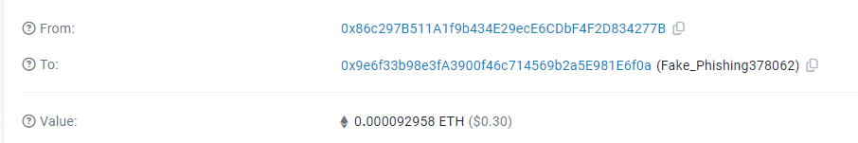
Example: ETH Transfer
Sender: 0x86c297B511A1f9b434E29ecE6CDbF4F2D834277B
Receiver: 0x9e6f33b98e3fA3900f46c714569b2a5E981E6f0a
Transfer: 0.000092958 ETH
Data can be found in transaction fields
Transaction Hash: 0x335f01c6ace6cc9e686c6a6a63c0fd95e7f29ba23ca3f12481e9a29953363236

Slide 29
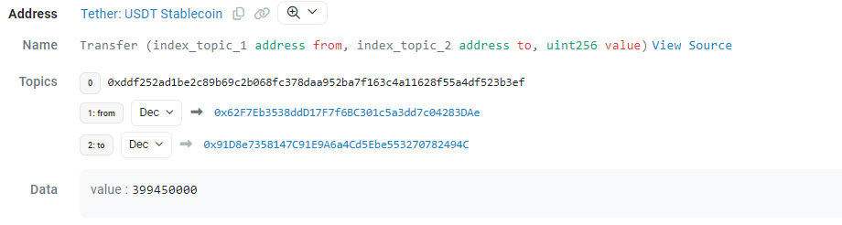
Example: ERC20 Transfer
Sender: 0x62F7Eb3538ddD17F7f6BC301c5a3dd7c04283DAe
Receiver: 0x91D8e7358147C91E9A6a4Cd5Ebe553270782494C
Transfer: 399.45 USDT
Data can be found in transaction log
Transaction Hash: 0x47e4e9ae3767a7d60203a0f64ef081b0d9fa366c03e9569fb9db5ca4ac9682ef

Slide 30
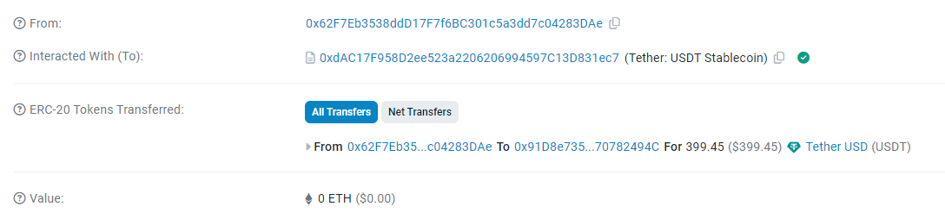
Transaction field:
To: the ERC20 token address
Value: 0 (otherwise “from” address will send ETH to the contract address)

Slide 31
NFT Trading Record
NFT transfer record can be located similar to ERC20
But trading record can only be found in the marketplace contract

Slide 32


Smart Contract Analysis
Every NFT marketplace deploys one or several smart contracts on chain
These smart contracts perform the core trading logics (e.g. price matching, fund transfer, transaction fee, ...)
1. Call Buy function
Transfer ETH from buyer
Buyer
2. Contract activate fund transfer (according to contract code)
Transfer NFT from seller
Emit Buy event
function Buy
Buy Log (Buyer, Seller, price)
Seller
Marketplace contract

Slide 33
Trading data is located in:
1. Event Log
Every trading record has a coresponding event log
Data field defined by the marketplace contracts
Some data needed may be missing as the contract does not include them
All event logs are visible
2. Function input
Should contain every piece of information to initiate a trade
Some data may need to refer to the contract’s member variable
Function input may be invisible because of recursive call
Both method need a certain degree of inference according to the contract logic to extract relevant data

Slide 34
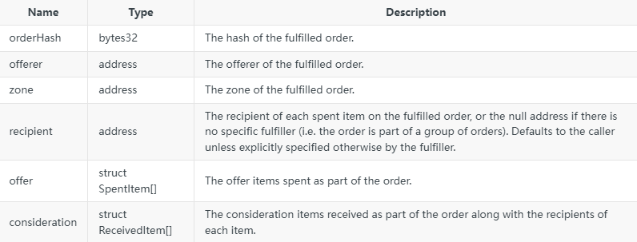
Example: Opensea Seaport
Key event: Orderfulfilled
‘offerer’ spends the items in ‘offer’ to recipient in return of ‘consideration’

Slide 35
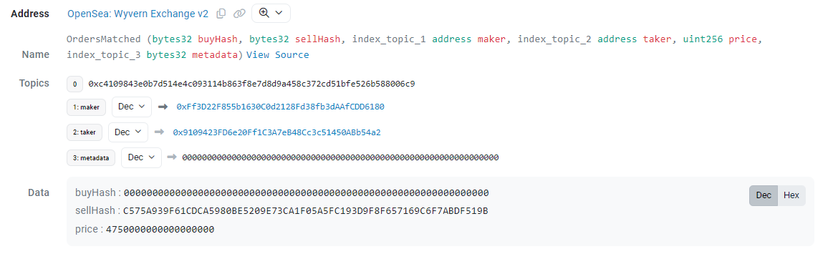
Example: Opensea Wyvern Protocol
Only one event emitted from the market place contract
No NFT data inside
Solution: Input data / NFT transfer log
Transaction Hash: 0x474ae3af949afc3304d885458c3da83e1ce63bbafd4559531a464713e4c87a42

Slide 36
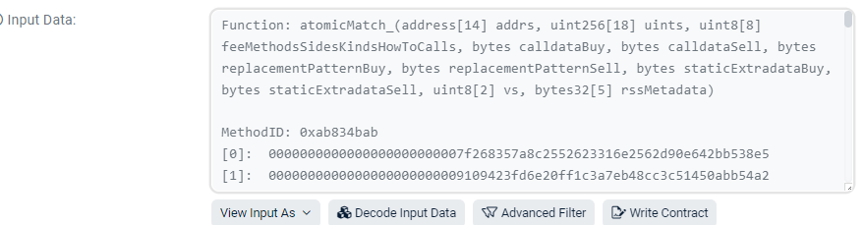
NFT data
Input data example
Why not referring to NFT log
Because log can be complicated when the function is called internally by another contract

